Slide 1

State of maine energy
ALY 6980 – Spring 2022

Slide 2


Executive summary
Executive Summary
The Roux Institute, in partnership with the Maine Governor's Office of Policy Innovation and the Future and the Governor's Energy Office, aims to provide a summary of key features of energy usage and pricing in Maine.
This includes descriptions of the current state on heating fuel consumption and pricing in Maine, comparisons to other New England states, and consumption and pricing forecasts. The outlook described will highlight challenges for Maine and promising trends for the future.

Slide 3


Historical Comparisons
Discuss how Maine compares historically to the other New England states when it comes to heat sources, energy consumption and fuel prices.
Visual Communications
Present new visuals that help the general public to understand the historical price, relative price, and relative efficiency of heating options.
Forecasting
xxxx
Examines the outlook for Maine in terms of energy usage and pricing and sets expectations for how this will change based on current patterns.
xx
3

Slide 4

Historical Comparisons
4

Slide 5
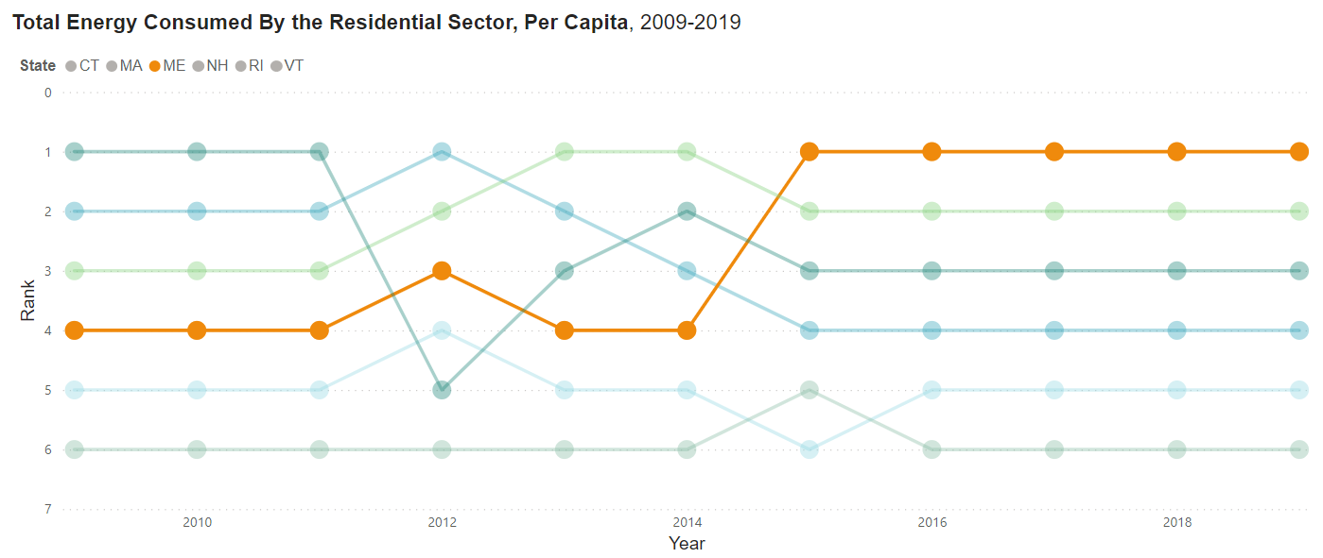
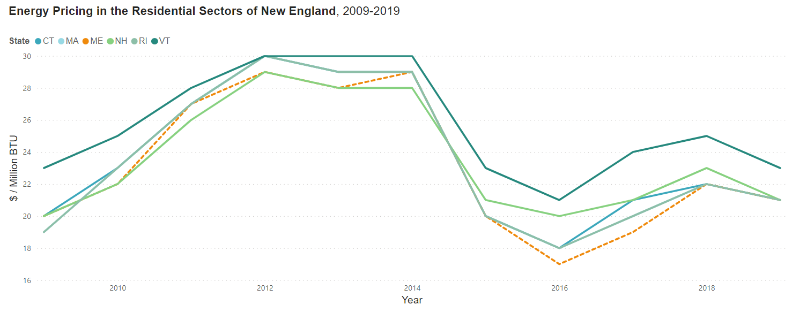
How does residential energy consumption and pricing in Maine compare to the rest of New England?
Maine's total energy consumed in the residential sector per capita began to outpace the rest of New England after 2015 and has led New England since
In the same timeframe, Maine’s total energy pricing was less than the rest of the New England

Slide 6
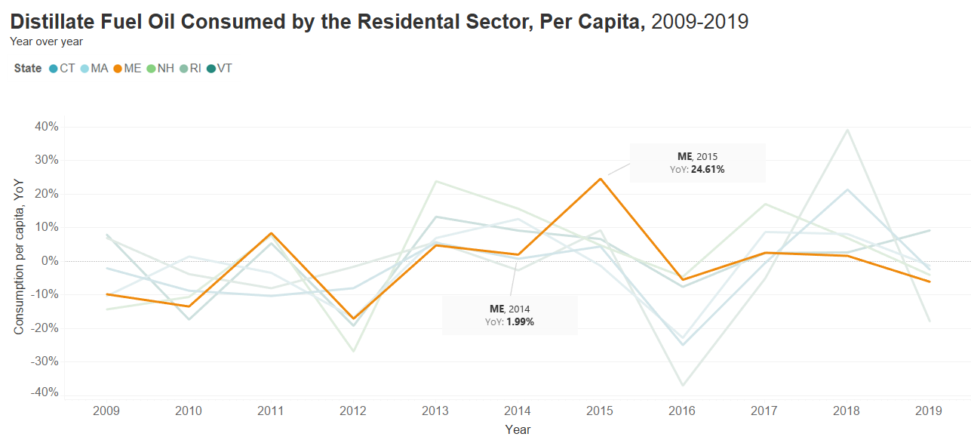
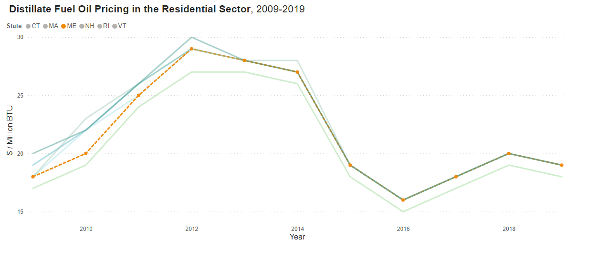
IS Maine MORE RESPONSIVE TO HEATING FUEL PRICE CHANGES THAN THE REST OF NEW ENGLAND?
From 2010 to 2014, Maine’s average annual oil consumption was ~26K Billion BTU, this increased to an annual average of ~31K Billion BTU from 2015 to 2019. A 19% increase. ​For reference, RI's annual average consumption dropped 19% in the same timeframe and the rest of NE combined dropped 5%.
Maine's distillate fuel oil consumed by the residential sector jumped 24% YoY from 2014 to 2015 likely due to falling oil prices and consumers buying in bulk in mid-2014​. The rest of New England increased by 5%
​

Slide 7
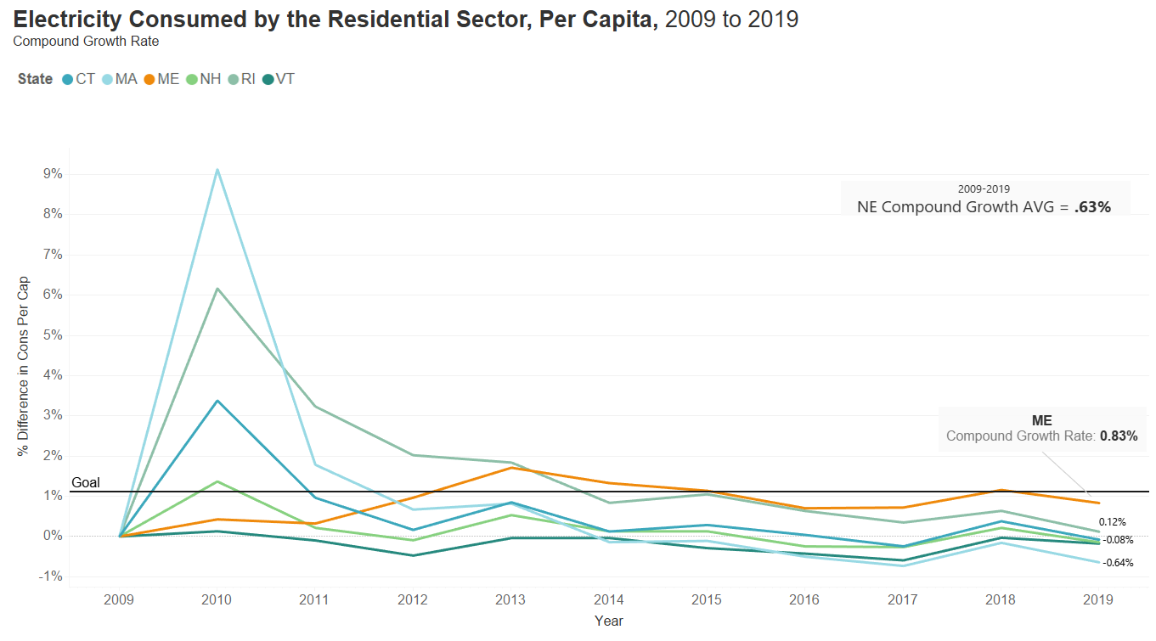
Is electricity consumption in new England growing slower than ISO NE expectations?
Overall electricity use is expected to increase, by 1.1% annually, from 121,692 GWh this year to 133,960 GWh in 2030 (ISO-NE).
From 2009 to 2019, the average compound growth was .63%
Based on SEDs data, Maine is leading New England in electricity consumption in the residential sector with a .8% compound growth rate from 2009 to 2019.

Slide 8
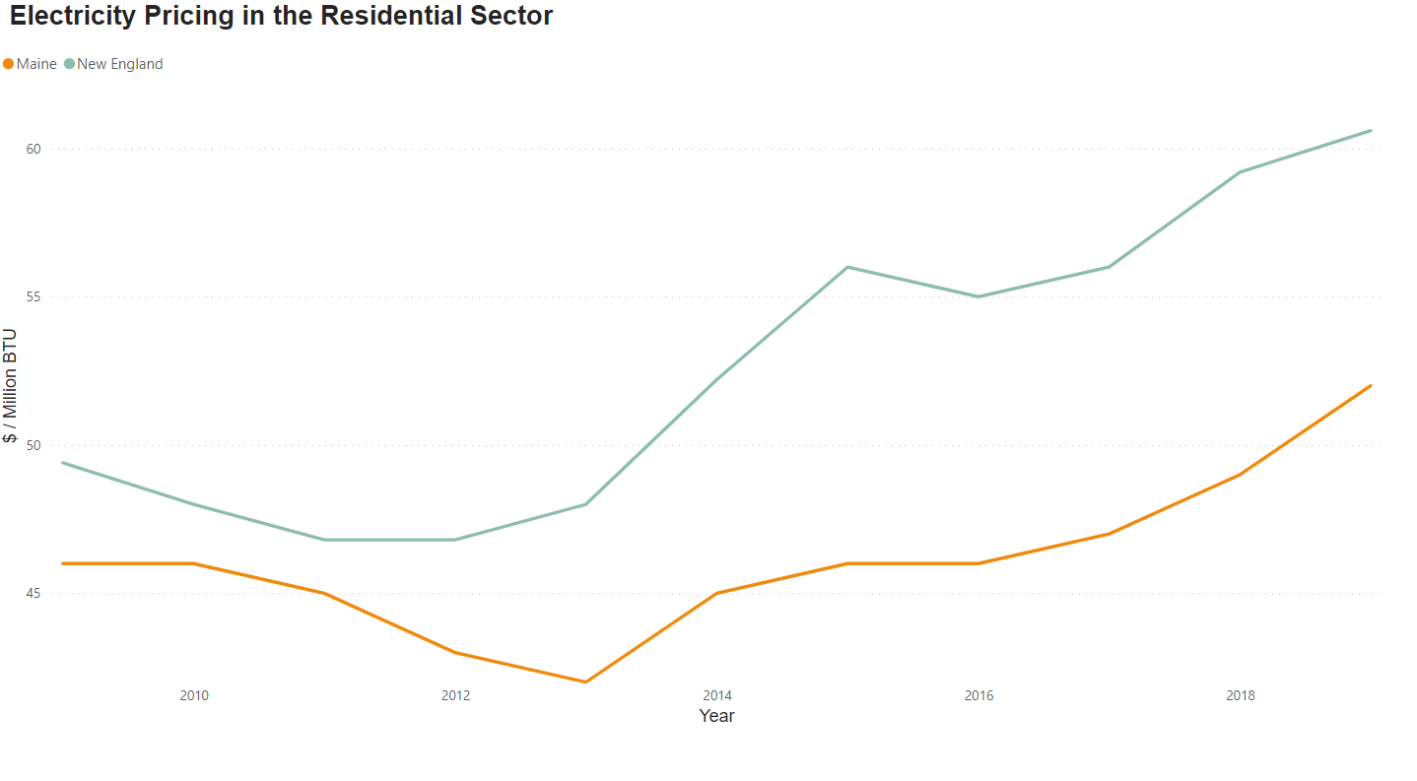
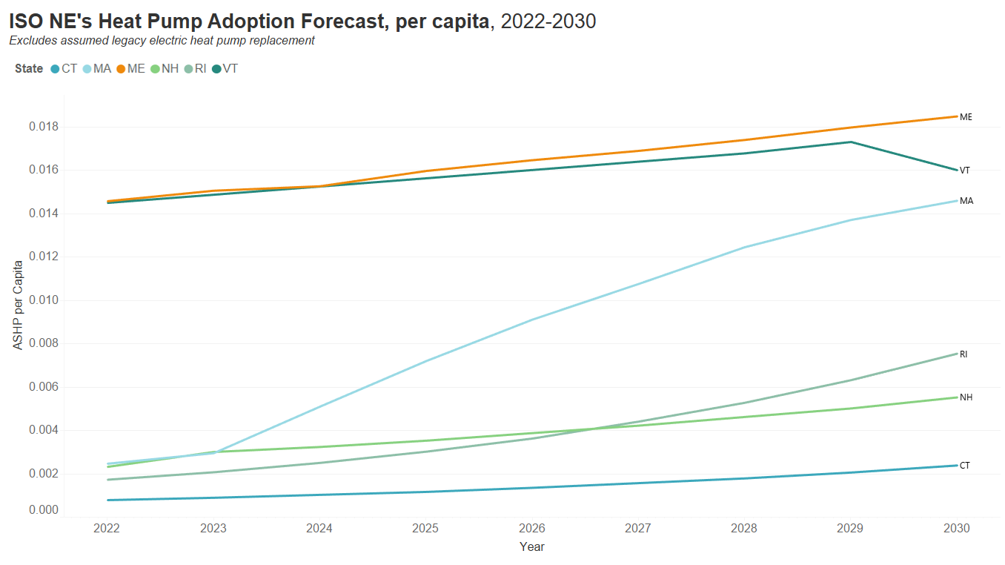
Maine will be a key player to meet ISO-NE’s growth expectations and NE state climate goals
On average, from 2009 to 2019, Maine’s cost per million BTU for electricity is 14% lower than the average across the rest of New England
Maine is forecasted to install the most heat pumps in New England per capita through 2030.
Forecast source:
https://www.iso-ne.com/static-assets/documents/2022/04/final_2022_heat_elec_forecast.pdf
Maine is a leader due to the .8% electricity per capita consumption growth rate, the lowest price of electricity, and its heat pump adoption “best-practice status” with .8% residential heat pump conversion rate (Acadia Center). This leadership position; however, may be due to limited access to non-oil heating options.

Slide 9
With limited access to natural gas, maine homeowners are left with fewer options than other states
ME
CT
MA
NH
RI
VT
Data: US Census
Tank Gas= Bottled, tank or LP Gas, Fuel oil=Fuel Oil, kerosene, etc., Other= coal or coke, wood, solar energy, other fuel, no fuel
Data: US Census

Slide 10
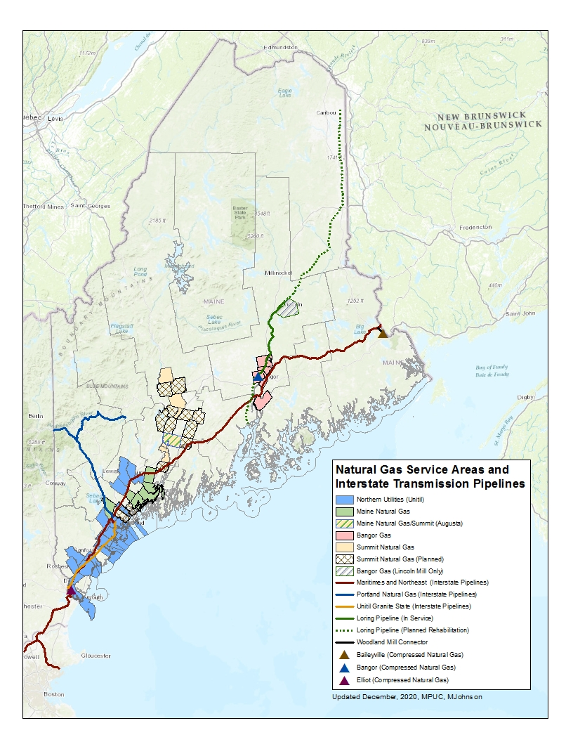
Most of the state lacks natural gas distribution systems, and so, only about 1 in 13 Maine households use natural gas as their primary home heating fuel.¹ Where natural gas service is available constraints on interstate pipeline delivery capacity force residents and businesses to compete with electricity generators for supply during the high-demand winter months.
¹US Energy Information Administration

Slide 11
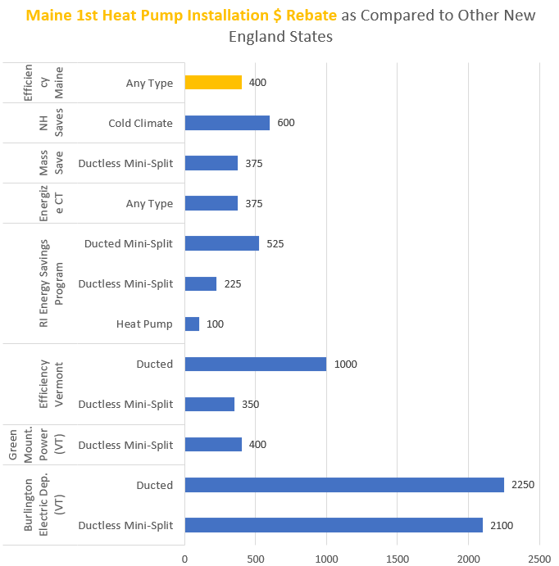
New England heat pump goals and rebates
Maine is one of the few New England states with a specific heat pump installation goal. The only state with a similarly stated goal, Massachusetts, has a 2.5% less aggressive installation goal per year per capita.
State​ | Heat Pump Related Goal​
Maine​ | 100,000 home heat pump installations by 2025 from 2020^{​1}
Massachusetts​ | 100,000 home heat pump installations every year from 2020 for the next 25-30 years²
NH, VT, CT, RI | No stated heat pump goal
However, Maine's rebate does not stand out against other states³
1 Maine Climate Council
2 Commonwealth of Massachusetts
3 Connecticut Department of Energy and Environmental Protection

Slide 12

Idea for further analysis: does adoption motivation differ based on homeowner status
When the homeowner is the occupant of a home, they are much less likely to have electricity as their primary heating source.
In NE, 29% of homeowners use fuel as their primary heating source, compared to 18% of rental units
In Maine, a renter is 4x more likely to have electricity as a heating source than fuel
Maine has the lowest percentage of renter occupied homes in New England, at 27%
One reason for this may be that landlords can establish rental agreements that give them a return on their heat pump investment. For instance, a landlord might rent finished units with the renter paying for utilities, in this case, primarily electrical. The landlord would then keep the meters in their name and bill the renters for their actual usage.

Slide 13
Visual Communications
13

Slide 14
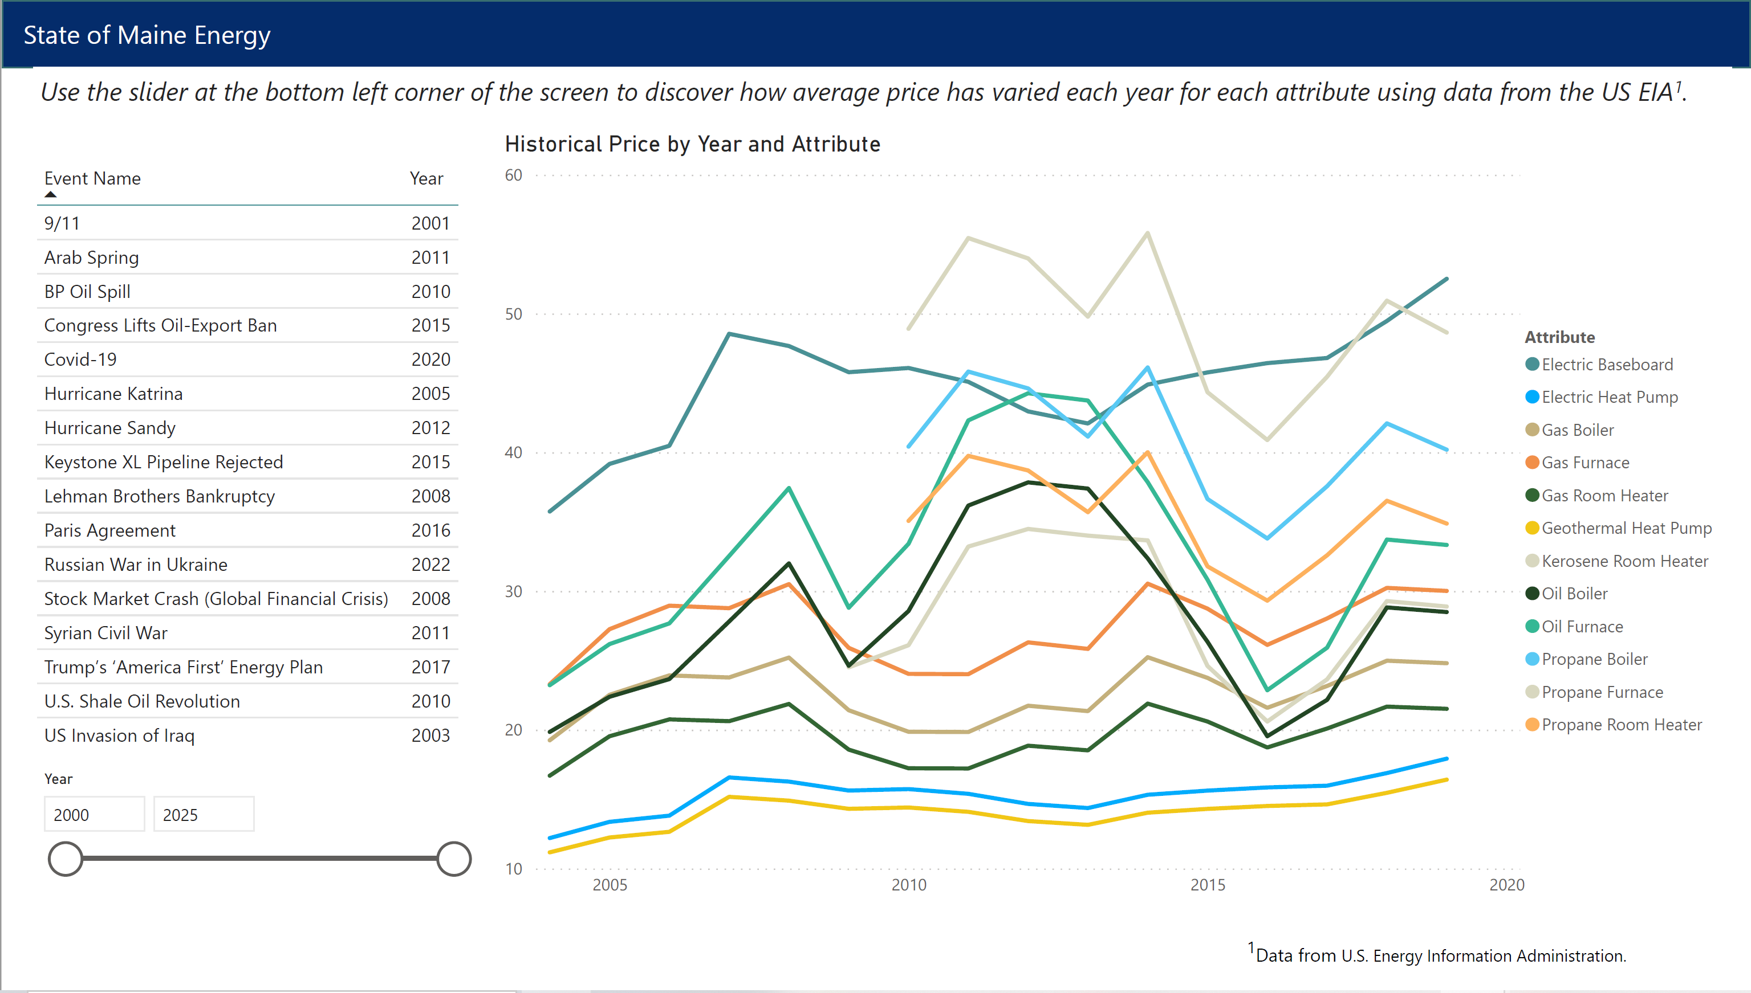
Historical Pricing with Historical Events

Slide 15
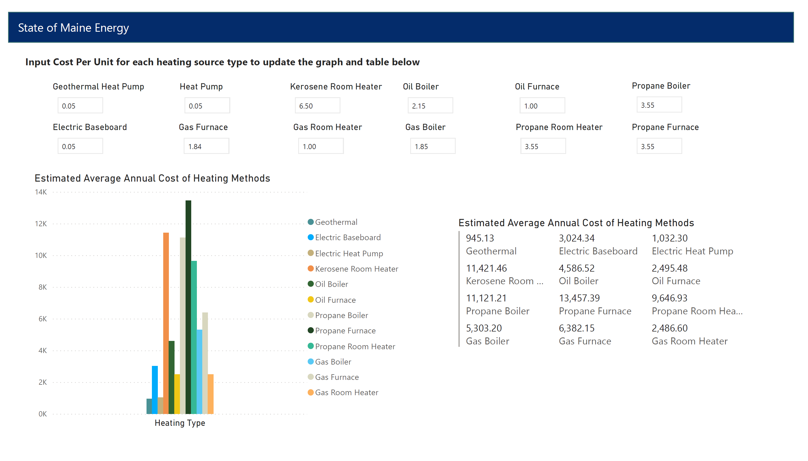
Efficiency Maine Calculator

Slide 16
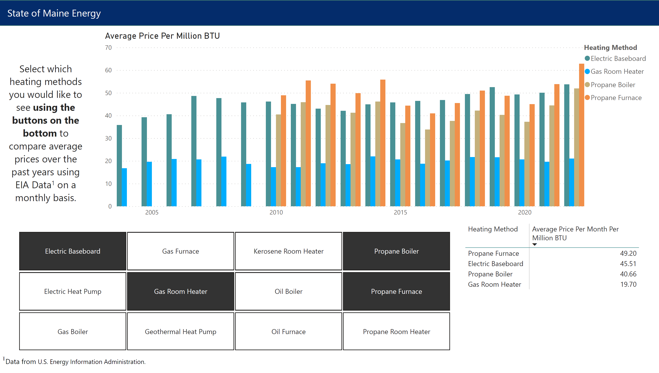
Average Price Per Million BTU

Slide 17
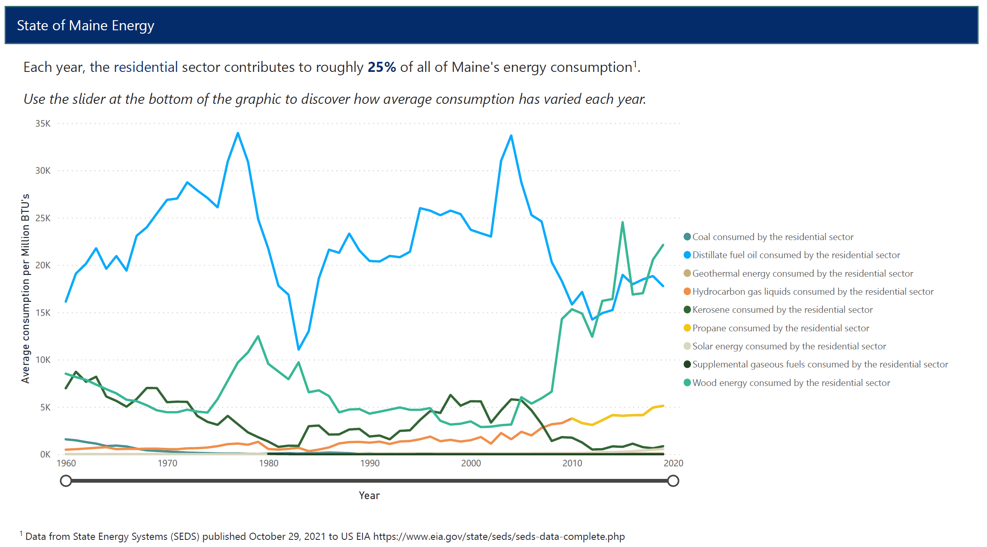
Average Consumption by Residential Sector

Slide 18
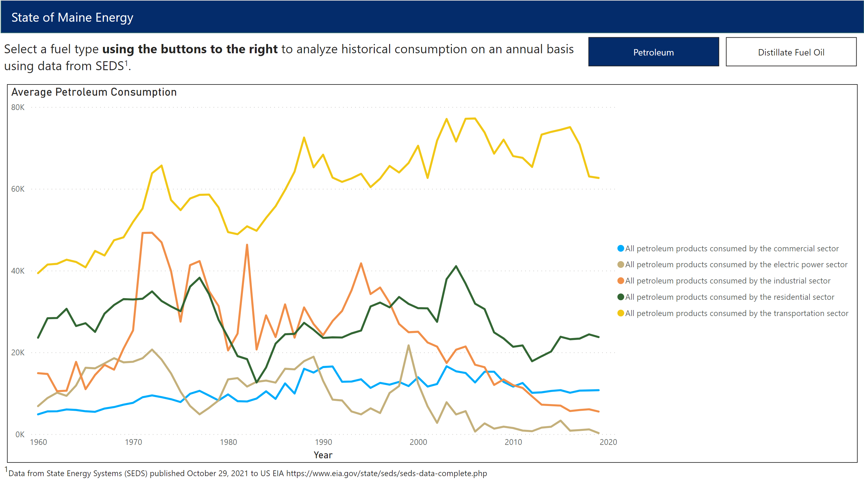
Average Consumption By Fuel Type

Slide 19
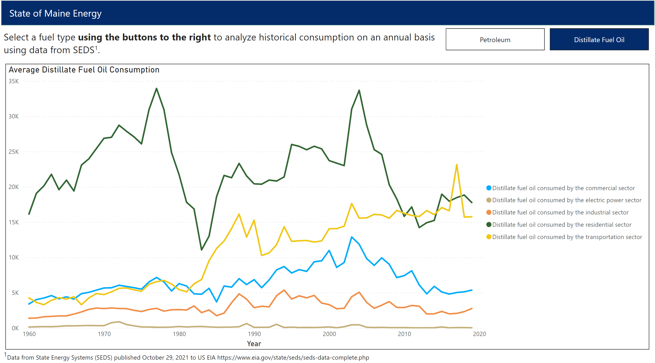
Average Consumption By Fuel Type

Slide 20
Forecasting
20

Slide 21
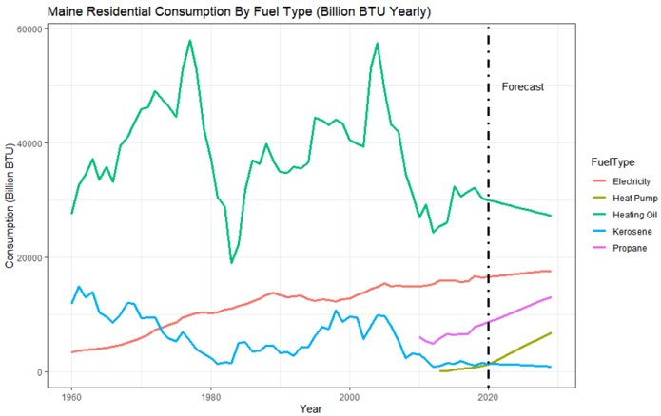
What does the Future of Energy Use in Maine look like?
Annual data was used to show the overall trend for consumption in Maine based on energy source over the next ten years.
Heating oil and kerosene show a decline in overall usage.
Electricity shows a positive trend while heat pump and propane both show a steep positive trend.
Consumption Data is from all historical data provided by State Energy Data Systems (SEDS) https://www.eia.gov/state/seds/seds-data-complete.php?sid=ME , while heat pump data comes from Efficiency Maine. Holt-Winters was applied to generate the forecast without the seasonal component.

Slide 22
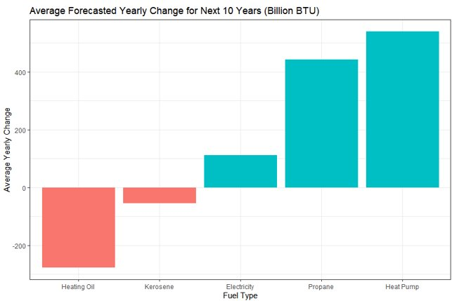
What Does the Annual Change look like?
Heat pumps lead the way in terms of yearly growth for BTU delivered, with an average annual increase of 527 Billion BTU annually based on current trend.
Propane is not far behind, and electricity shows a slow and steady increase.
Heating oil is seeing significant yearly decreases of 275 Billion BTU over the next ten years.

Slide 23
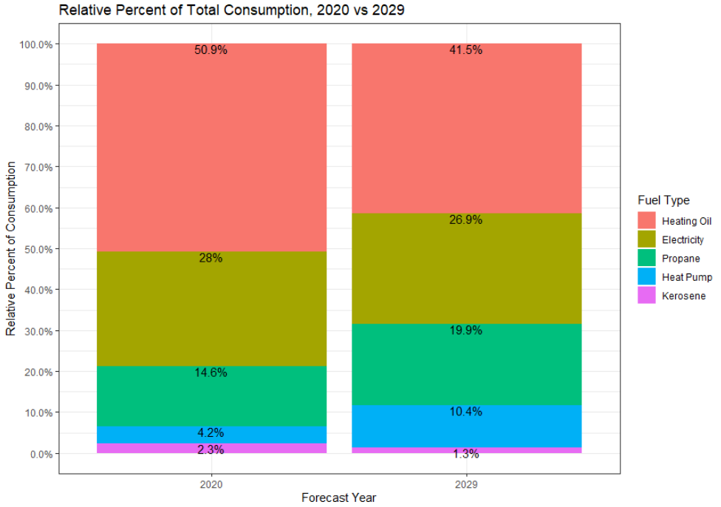
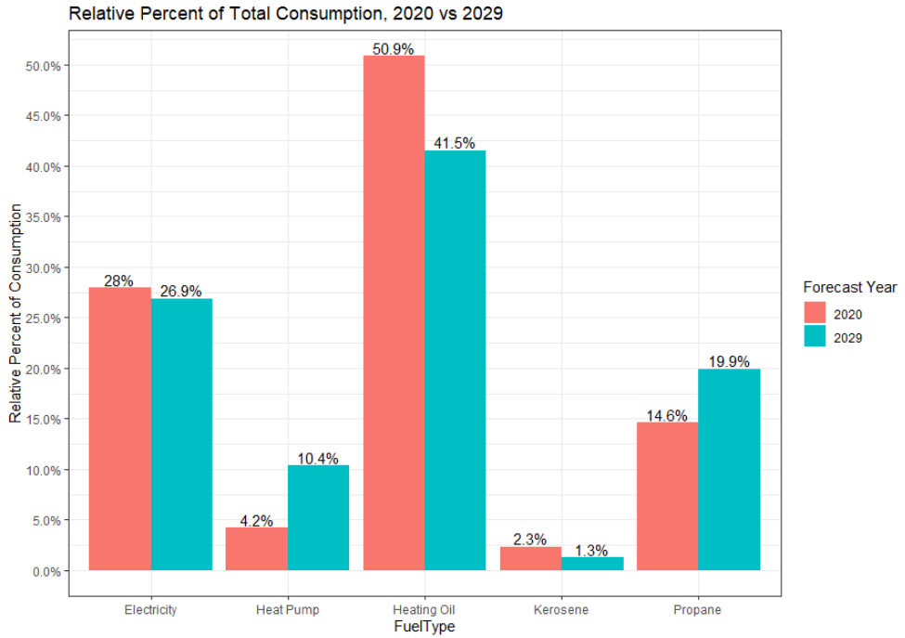
How Does Maine's Usage Change by 2029?
The relative share of the energy market is shown for 2020 and 2029. At current trend, Maine can reduce heating oil usage from 51% to around 41%, and heat pumps can serve roughly 10% of Maine's energy needs.

Slide 24
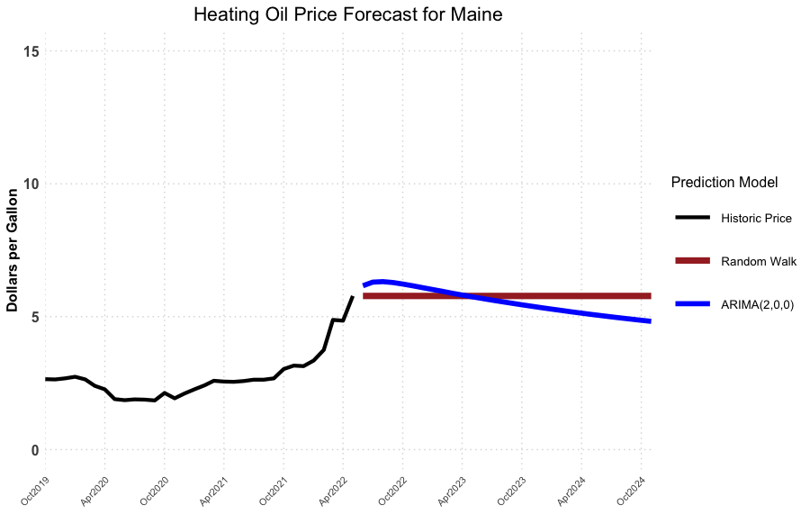
How much can maine residents expect to pay for heating oil in the next two heating seasons?
 | Random Walk Model | ARIMA(2,0,0) Model
Oct 2022 | $5.78 per gal | $6.23 per gal
Oct 2023 | $5.78 per gal | $5.45 per gal
Model Definitions:
ARIMA(p,d,q):
ARIMA = AutoRegressive Integrated Moving Average, with:
p = # of autoregressive terms
d = # of differences needed for
stationarity
q = # of lagged terms for moving
average
Random Walk:
Future steps or directions cannot be predicted on the basis of past history, so the best guess is the most recently known value.

Slide 25
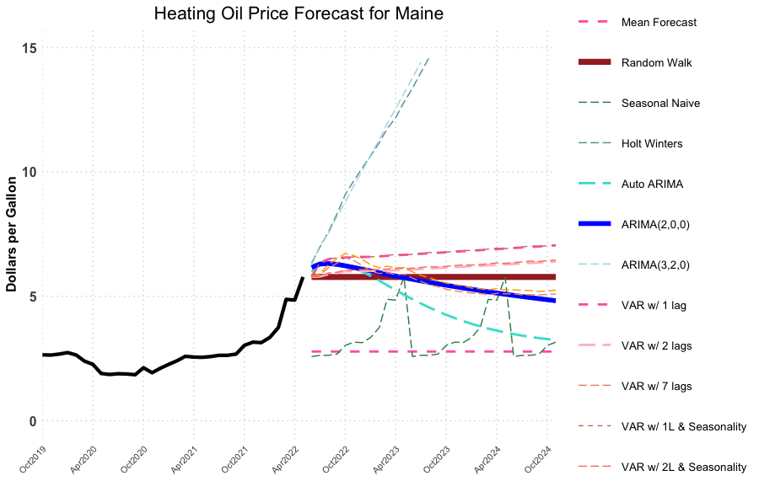
How accurately can we predict the price of heating oil for upcoming heating seasons?
Model | 1-mo MAPE* | 6-mo MAPE* | 18-mo MAPE*
Mean | 22.782% | 23.124% | 23.993%
Random Walk | 3.422% | 13.039% | 28.176%
Seasonal Naive | 18.684% | 19.132% | 32.561%
Holt Winters | 4.226% | 14.909% | 38.484%
Auto Arima | 3.435% | 13.508% | 28.885%
Arima(2,0,0) | 3.444% | 12.828% | 22.685%
Arima(3,2,0) | 3.659% | 18.674% | 51.987%
VAR (1 lag) | 3.326% | 13.109% | 28.358%
VAR (1 lag w seasonality) | 3.414% | 13.080% | 28.345%
VAR (2 lags) | 3.580% | 13.116% | 28.341%
VAR (2 lags w seasonality) | 3.702% | 13.105% | 28.332%
VAR (7 lags) | 4.692% | 13.402% | 28.398%
VAR (7 lags w seasonality) | 4.885% | 13.541% | 28.415%
* MAPE = Mean Absolute Percentage Error

Slide 26
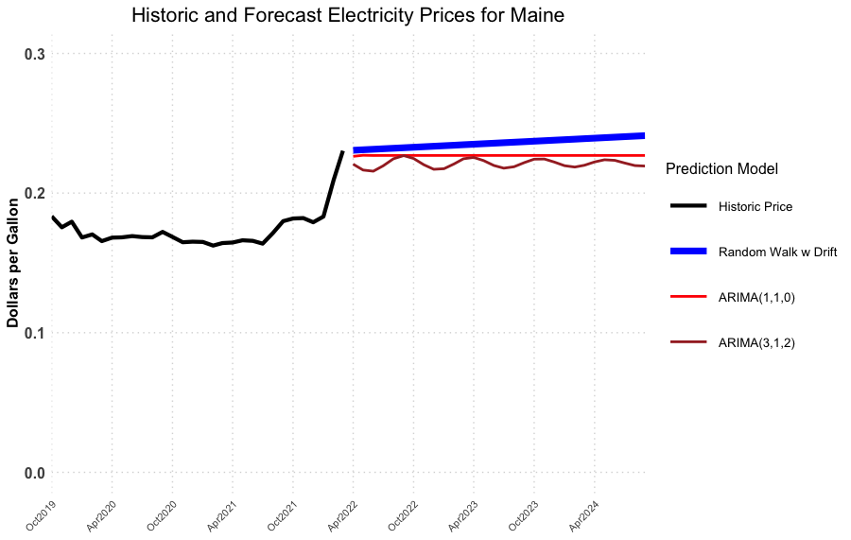
How much can maine residents expect to pay for electricity in the next two heating seasons?
Model Definitions:
ARIMA(p,d,q):
ARIMA = AutoRegressive Integrated Moving Average
p = # of autoregressive terms
d = # of differences needed for stationarity
q = # of lagged terms for moving average
Random Walk with Drift:
Future steps or directions cannot be predicted on the basis of past history, so the best guess is the most recently known value with a small drift/trend term added.
 | Random Walk with Drift Model | ARIMA (1,1,0) Model | ARIMA (3,1,2) Model
Oct 2022 | $0.233/kWh | $0.227/kWh | $0.225/kWh
Oct 2023 | $0.237/kWh | $0.227/kWh | $0.224/kWh

Slide 27
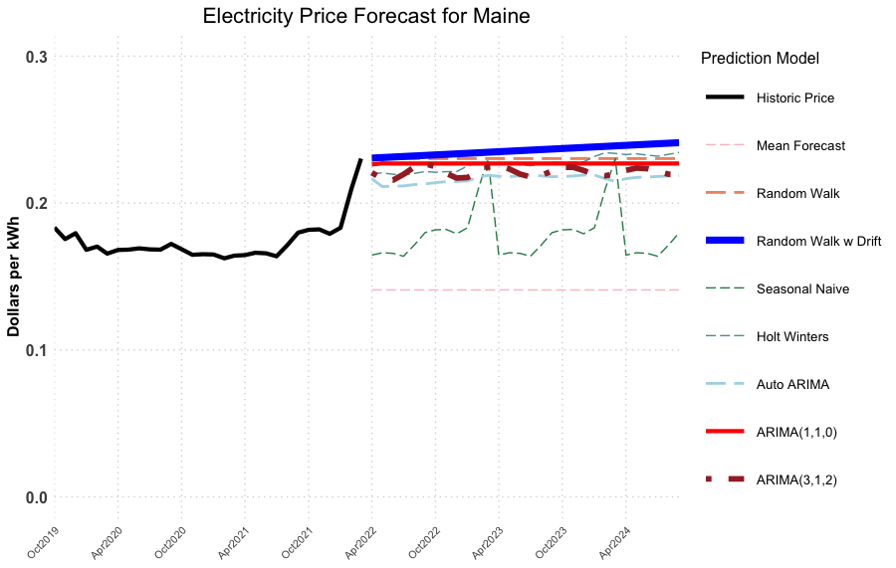
How accurately can we predict the price of electricity for upcoming heating seasons?
Model | 1-mo MAPE | 6-mo MAPE | 18-mo MAPE
Mean | 15.155% | 15.684% | 17.792%
Random Walk | 1.518% | 3.341% | 5.424%
Random Walk with Drift | 1.506% | 3.298% | 4.947%
Seasonal Naive | 4.450% | 4.404% | 6.012%
Holt Winters | 1.762% | 3.633% | 5.467%
Auto Arima | 1.659% | 3.299% | 5.160%
Arima(3,1,2) | 1.691% | 3.187% | 5.340%
Arima(1,1,0) | 1.522% | 3.286% | 5.373%
* MAPE = Mean Absolute Percentage Error

Slide 28
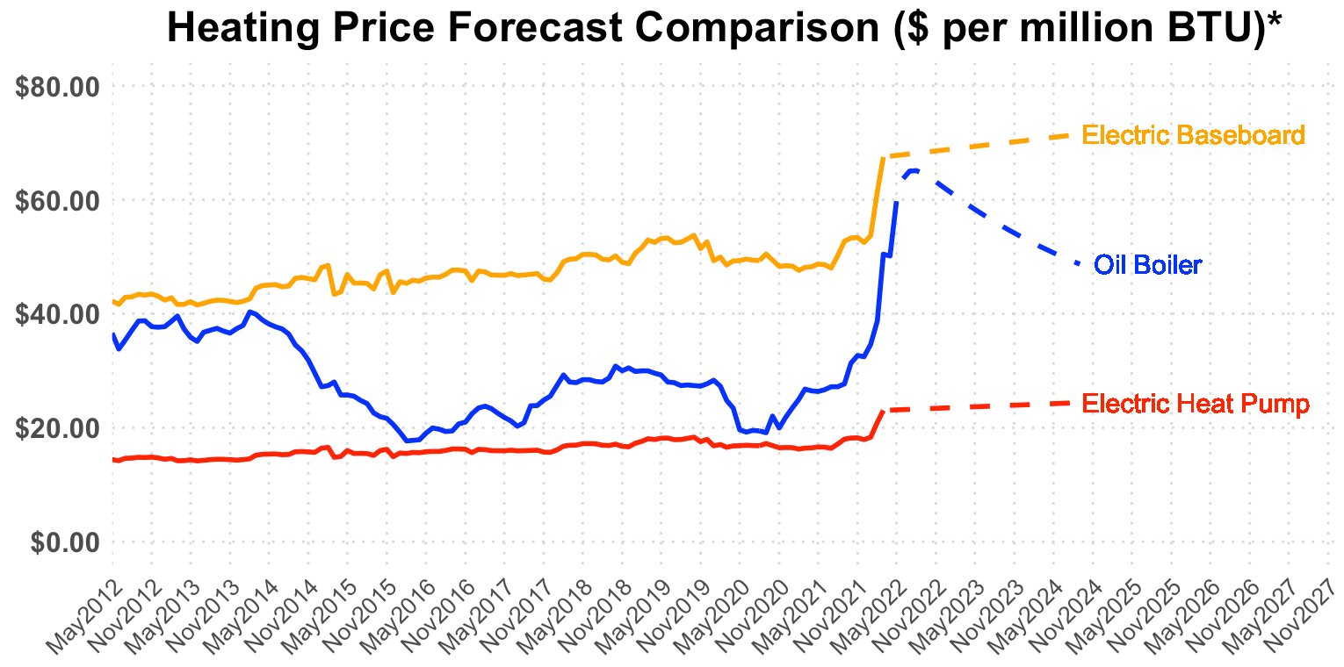
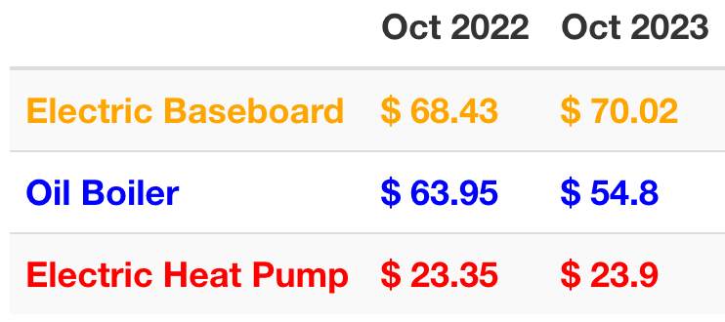
How do the forecasted prices compare in terms of $ per btu?
Oil Boilers
are expected to cost
~2.5x as much as Electric Heat Pumps
to heat a house in Maine for each of the next two heating seasons
* Calculating dollars per million BTU for each heating type was performed using BTU’s per unit, system efficiencies, and distribution efficiencies obtained from Efficiency Maine.

Slide 29

Questions

Slide 30
Appendix

Slide 31
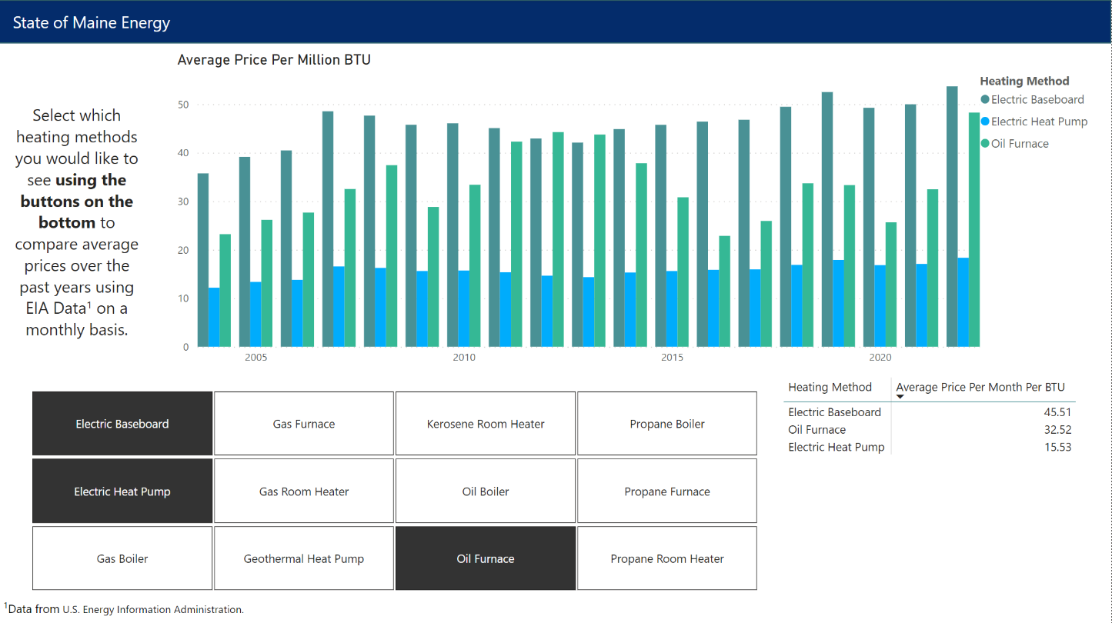
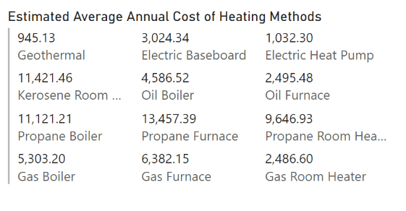
Creative Brief – Suggestion for the GEO
We suggest that the GEO work with a professional graphic designer to create additional graphics that can better convey a complicated combination of messages.
As we've seen Mainers are particularly responsive to changes in prices.
We suggest using a graphic designer to create a compelling graphic or story board related to the cost of heating options and the relative stability of price. The graphic should combine the following two insights:
The price of electric options has remained steady while oil pricing tends to fluctuate
Electric heat pumps are significantly more efficient than boilers or furnaces

Slide 32
CT
ME
MA
NH
RI
VT

Slide 33
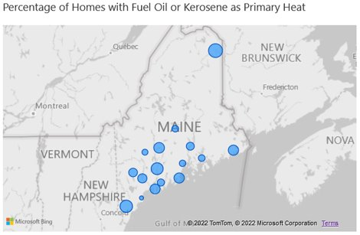
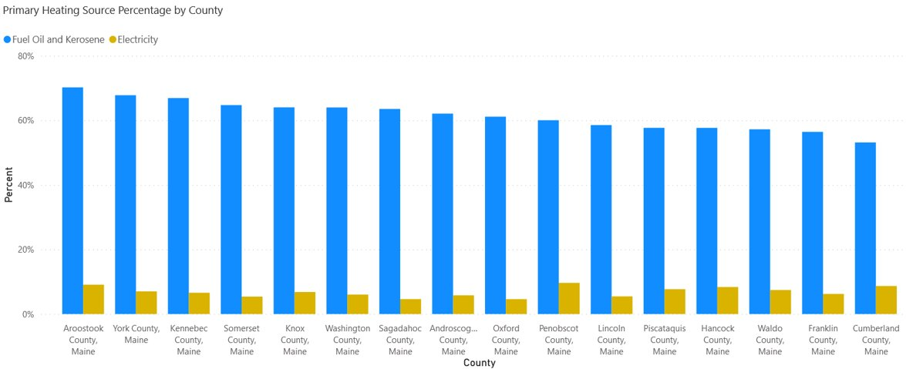
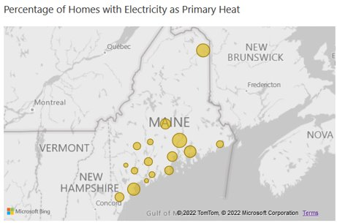
Comparing Maine's Counties
Penobscot County leads the way in primary heating coming from electricity at almost 10%, while Oxford and Sagadahoc are less than 5%. Cumberland county has the lowest percentage of heating oil and kerosene as primary heat at 53%, while Aroostook County is highest at 70%.
Data Obtained from U.S. Census Bureau based on 2020 ACS Five Year Estimates https://data.census.gov/cedsci/table?q=fuel%20source&g=0400000US23,23%240500000&tid=ACSDT5Y2020.B25040&moe=false&tp=true

Slide 34
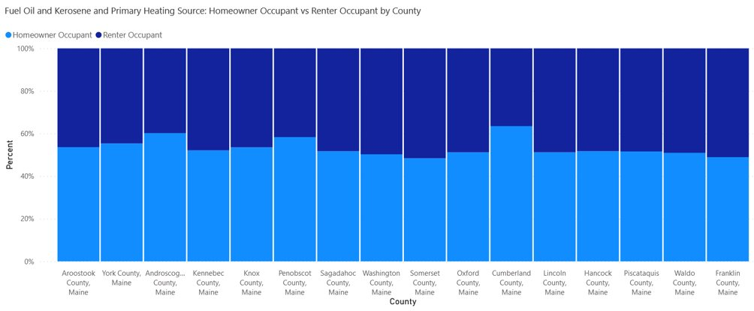
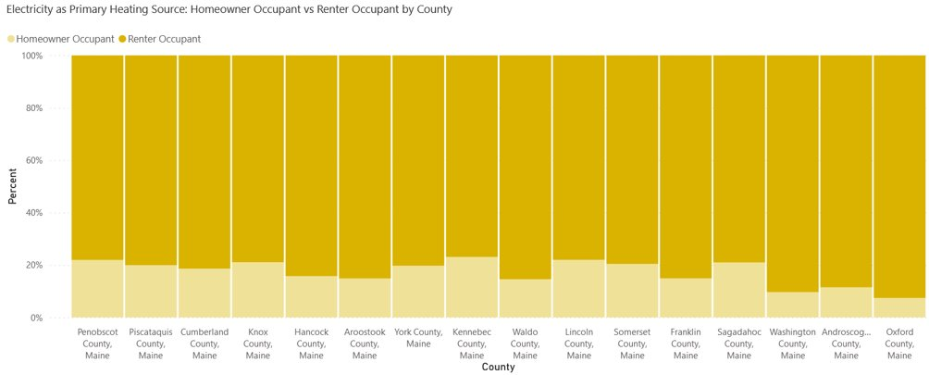
Comparing Renters and Owners
Census Data shows that when the homeowner is the occupant of a home, they are much less likely to have electricity at their primary heating source. In Maine as a whole, a renter is 4 times more likely to have electricity as a heating source than fuel oil or kerosene.
65% of homeowner occupied homes have fuel oil or kerosene as their primary heating source, as opposed to 51% for renter occupied homes.
Only 4% of homeowner occupied homes in Maine have electricity as primary heat source, compared to 17% for rental units.
Data Obtained from U.S. Census Bureau based on 2020 ACS Five Year Estimates https://data.census.gov/cedsci/table?q=fuel%20source&g=0400000US23,23%240500000&tid=ACSDT5Y2020.B25040&moe=false&tp=true

Slide 35
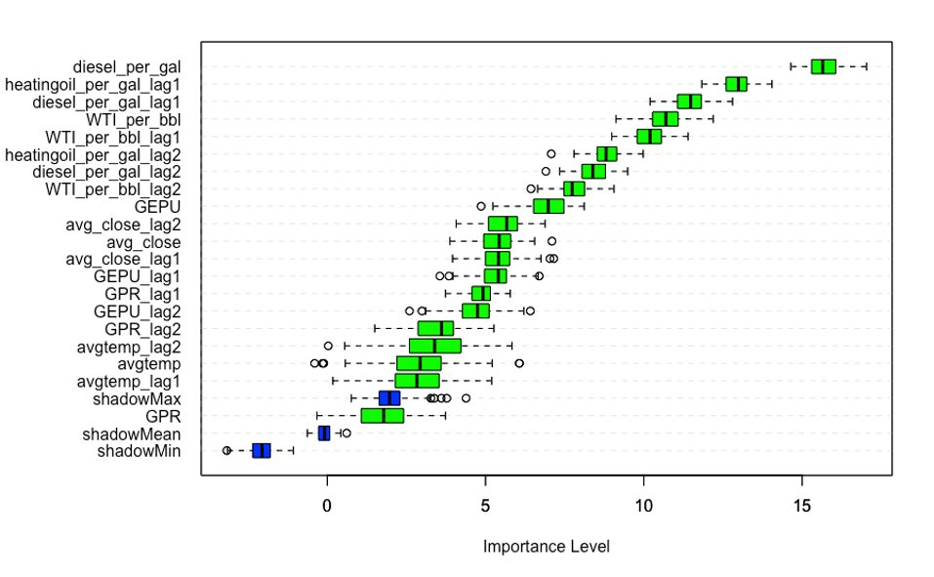
What external factors have the largest effect on PREDICTING the price of heating oil?
Variable importance analysis using the Boruta algorithm and 100 random forest iterations with all variables, including 2 lags for each.
New England Diesel Price
Maine Heating Oil Price (lag 1)
New England Diesel Price (lag 1)
Crude Oil Price
Crude Oil Price (lag 1)
Maine Heating Oil price (lag 2)
New England Diesel Price (lag2)
Crude Oil Price (lag 2)
Economic Policy Uncertainty Index
S&P500 Avg. Closing Price (lag 2)
S&P500 Avg. Closing Price
S&P500 Avg. Closing Price (lag1)
Economic Policy Uncertainty Index (lag 1)
GeoPolitical Risk Index (lag 1)
Economic Policy Uncertainty Index (lag 2)
GeoPolitical Risk Index (lag 2)
Average Maine Temperature (lag 2)
Average Maine Temperature
Average Maine Temperature (lag 1)
"shadow Max"
GeoPolitical Risk Index
"shadow Mean"
"shadow Min"

